Slide 1


Research Made Simple – The Virtual Library & APA
MRU Library
Notes:
Welcome to the MRU Library workshop, Research Made Simple. In this session, I’ll show you how to use the Virtual Library to find academic sources and how to cite them correctly using APA 7.

Slide 2

Workshop Goals
Search effectively in Library databases
Use filters and advanced search tools
Cite reliable APA resources
Notes:
Our Goals for this workshop are to teach you: How to access the MRU Virtual Library, how to search effectively inside library databases, how to refine your search using tools and filters, how to access full-text articles, and finally, how to cite the resources you find.

Slide 3
What is The Virtual Library?
Platform with multiple databases.
Access to peer-reviewed, full-text articles.
Free through your library login.
Notes:
The Virtual Library is an online platform that gives you access to multiple academic databases and the library catalog. All resources are peer-reviewed, full text, and free through your MRU login.

Slide 4


Accessing The Virtual Library
Go to your Moodle via the Student Portal.
Click on Resources on the top Menu.
Click Virtual Library.
Choose a Database to Search with.
Start Searching.
Notes:
To access the Virtual Library, log into Moodle through the Student Portal. Click Resources, then select Virtual Library. From there, you can choose a database and begin searching.

Slide 5
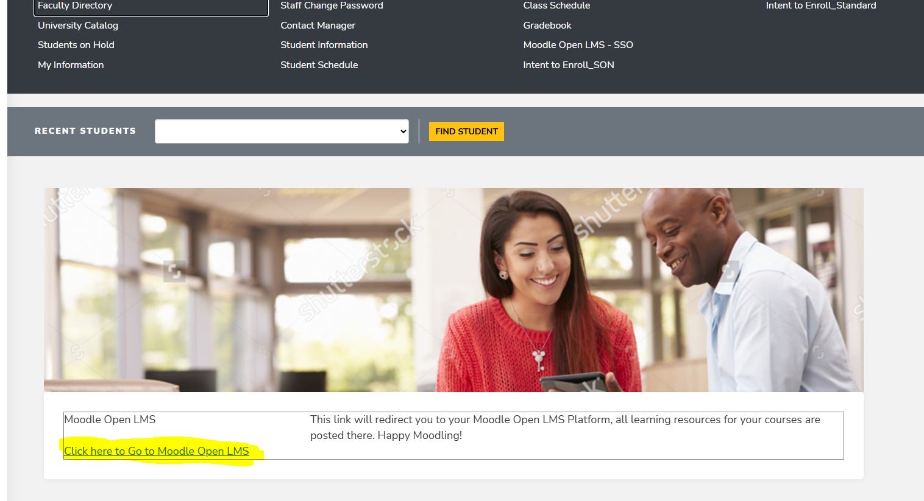
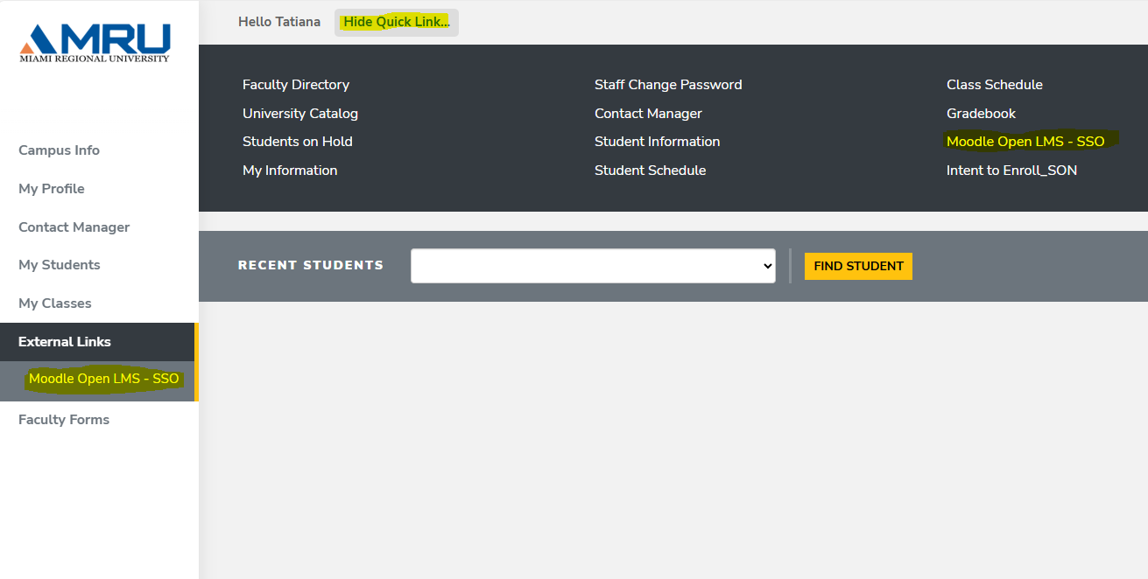
How to Access Moodle & The Virtual Library
Moodle can be found in your Student Portal Under Quick Links up top or External Links on the Left-hand Side.
Notes:
Moodle can be found in your Student Portal under Quick Links at the top, or under External Links on the left-hand side.

Slide 6
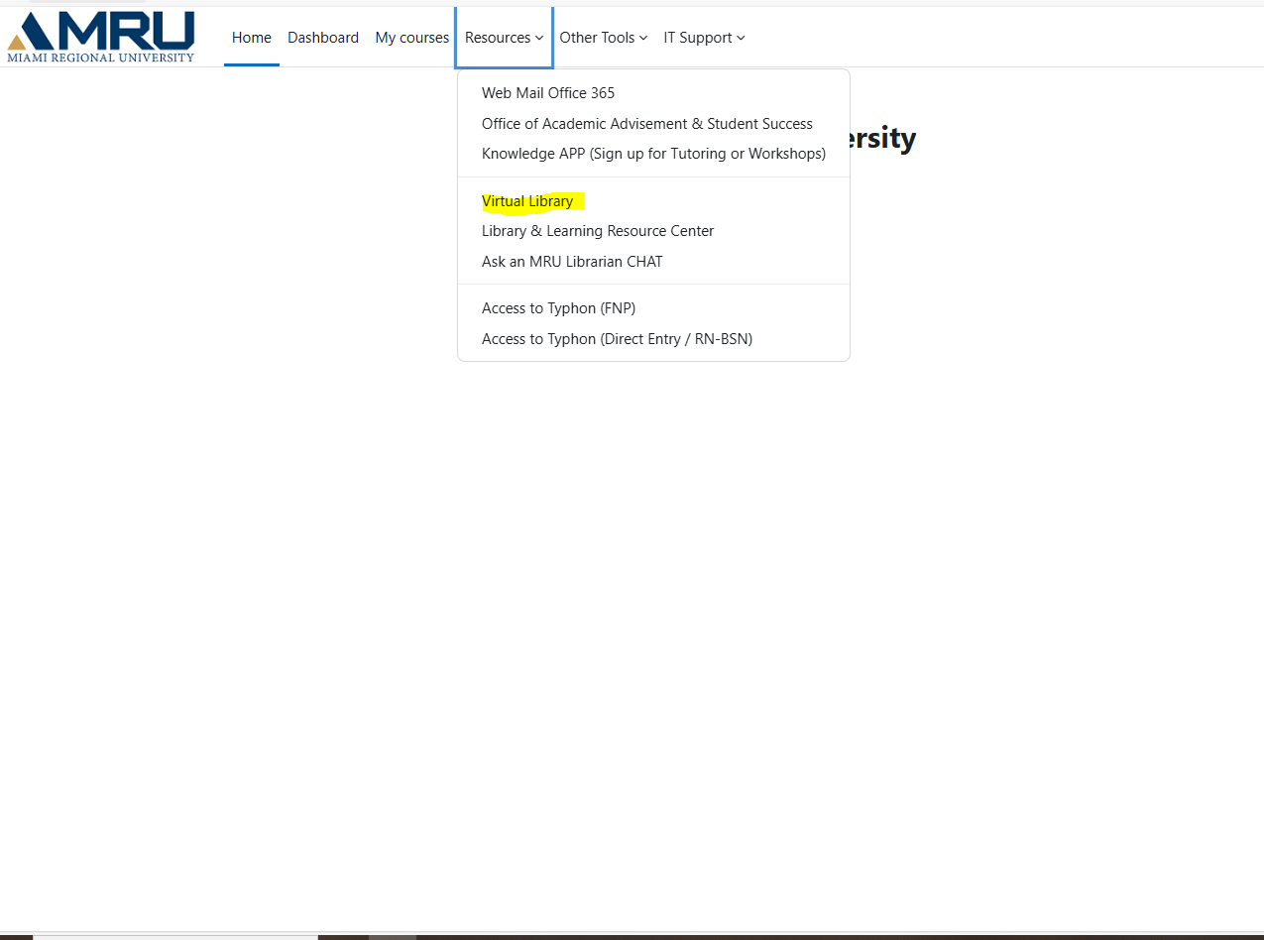
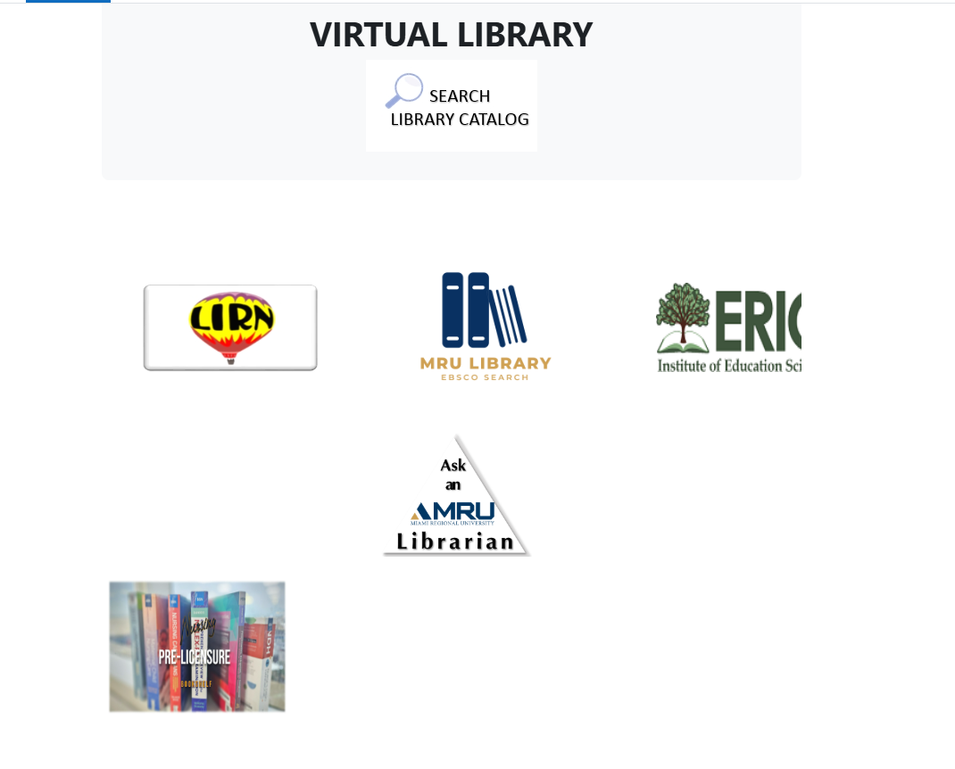

How to Access the Virtual Library
Once Your Moodle is open, Click on Resources on the top menu then Virtual Library.
Now you are Ready to Pick a Database!
Notes:
Once Moodle is open, click Resources on the top menu, then select Virtual Library. You’re now ready to choose a database.

Slide 7



How to Access LIRN
Click LIRN
Notes:
First we'll access LIRN by clicking the LIRN logo in the Virtual Library.

Slide 8
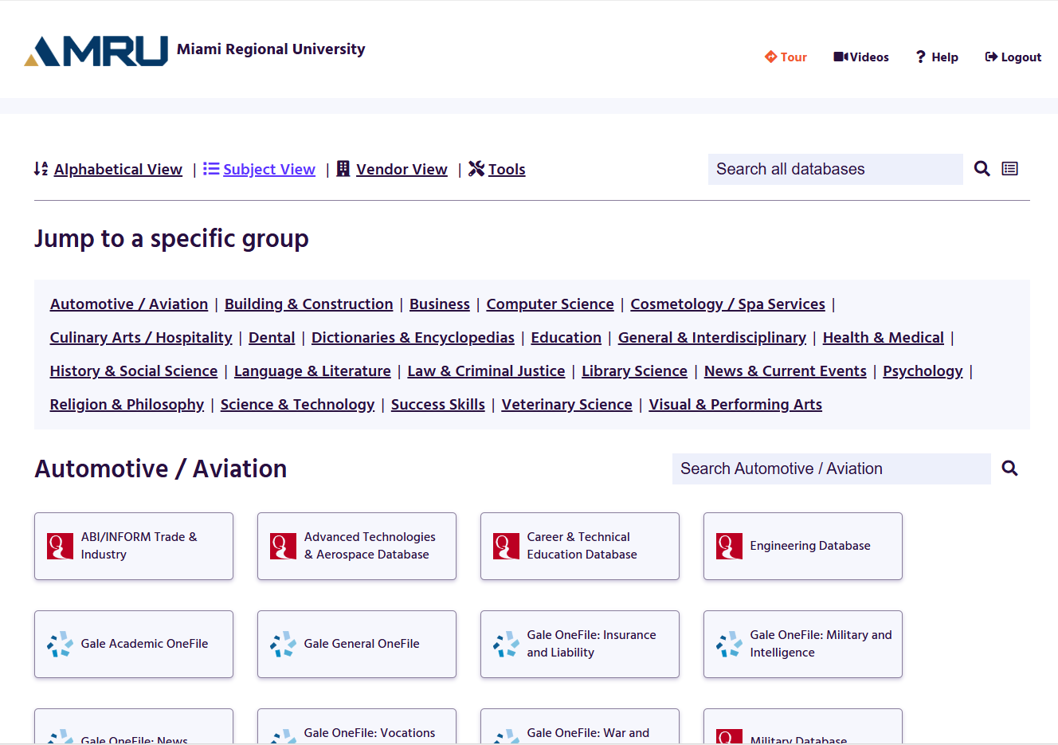
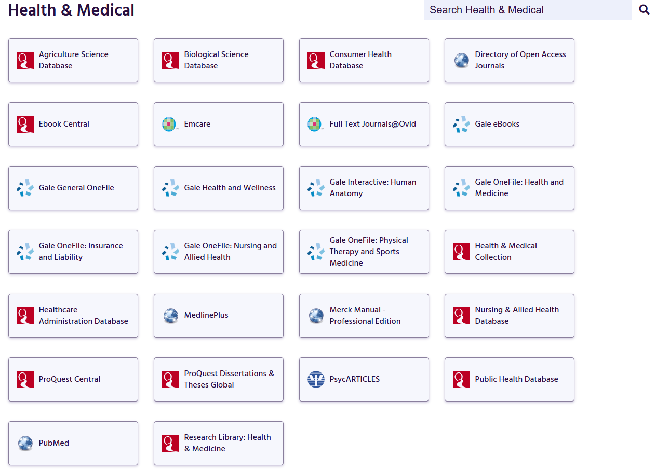
Accessing LIRN
Notes:
Opening LIRN from the Virtual Library will bring up this database directory where you can choose specific databases to search in. For example, Here we scrolled down to the Health and Medical directory and will be choosing PubMED as our Database.

Slide 9
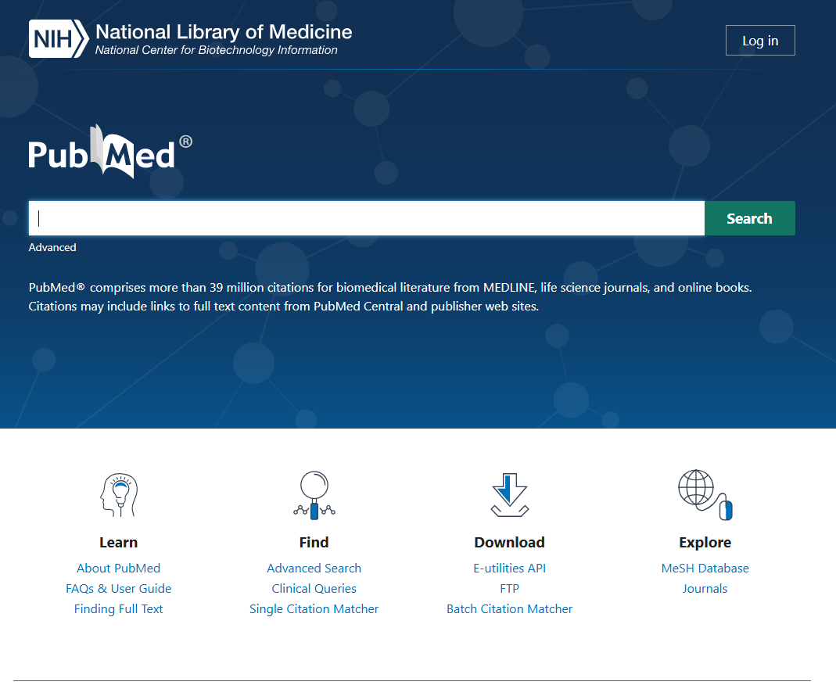
Accessing LIRN
Now that the PubMed database is open, we can begin searching.
Notes:
Once we click on our database it will pop up ready to search.

Slide 10
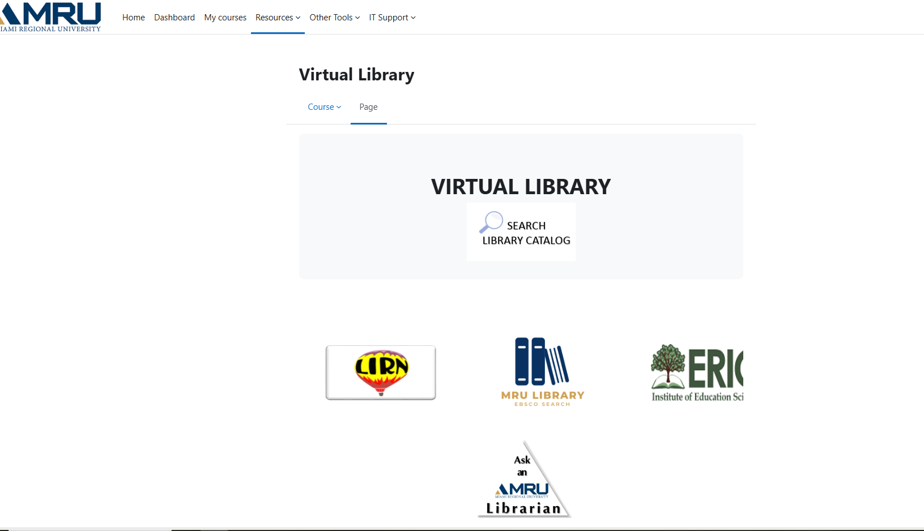
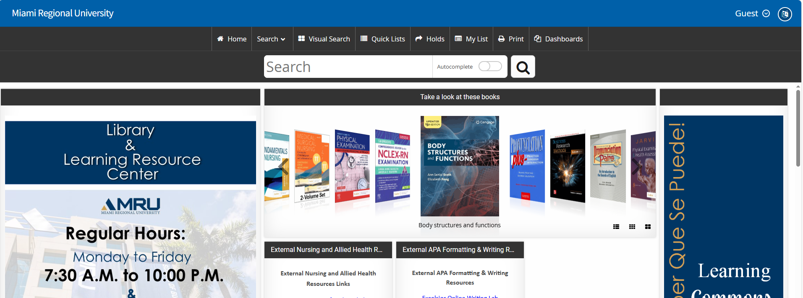
How to Access the Library Catalog
Notes:
The Library Catalog is where you search for physical books located on campus. Click ‘Search Library Catalog’ and you’ll be able to browse all books available in the 9th-floor collection.

Slide 11
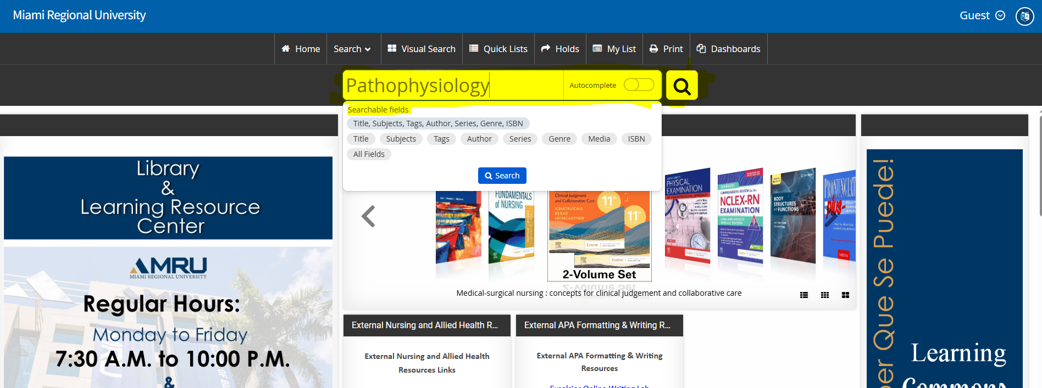
Searching & Accessing Books in The Library Catalog
Keywords in the search bar can be further narrowed down by using searchable fields.
Notes:
Use the search bar to find books by keyword, author, subject, or various other searchable fields.

Slide 12
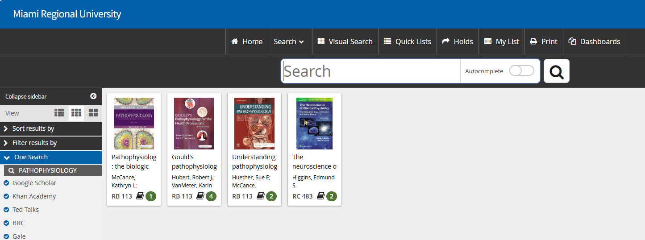
Searching & Accessing Books in The Library Catalog
Once your search is complete any books that may be available in the physical library using your search terms will populate.
Notes:
Click on a book to view more details, including whether it’s available or checked out.

Slide 13
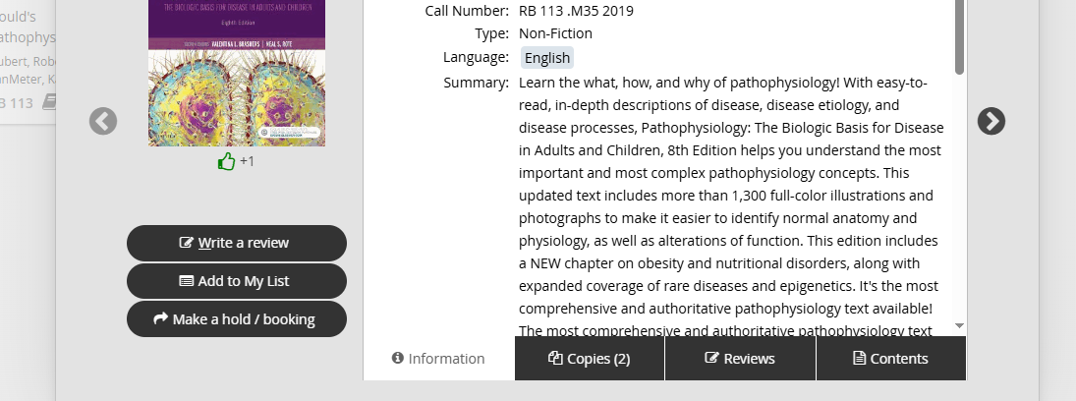
Searching & Accessing Books in The Library Catalog
The Library Catalog has a database of every book we currently have at the physical library.
Please call us to put a hold on any books you may want.
Notes:
Once you open a book record, you’ll see availability and location details. If you want to put a book on hold, please call the library.

Slide 14
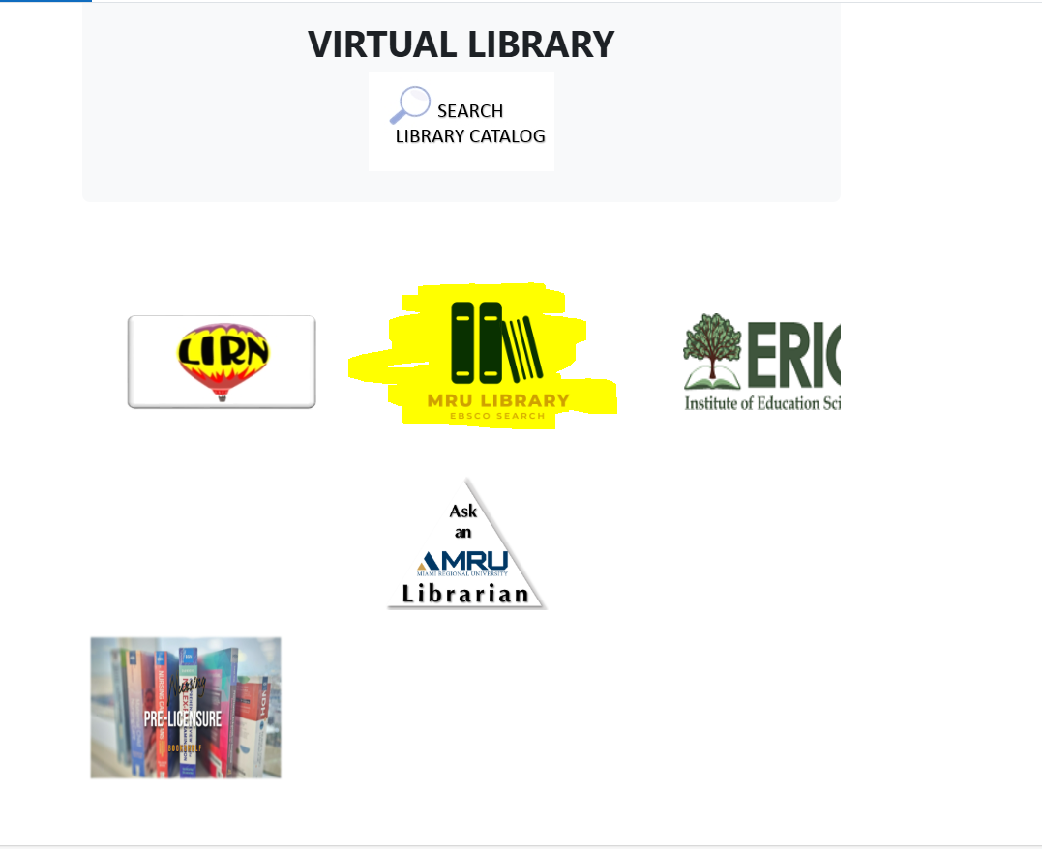
How to Access EBSCO
Notes:
To access EBSCO, simply click the ‘MRU Library EBSCO Search’ logo. You can also go directly to Library.mru.edu.

Slide 15
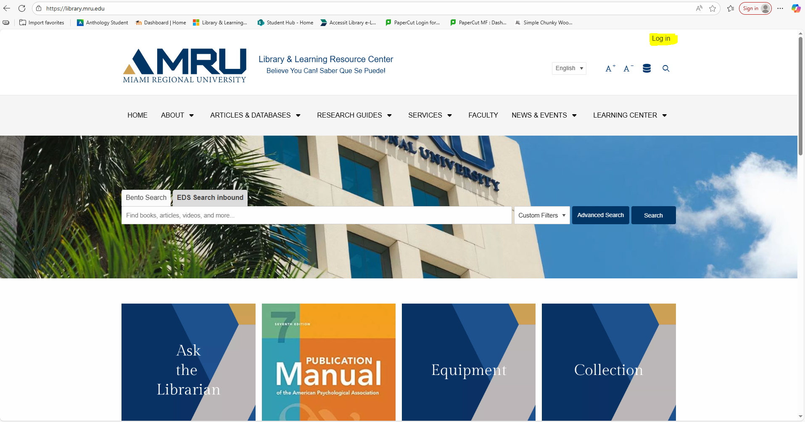
Accessing EBSCO
Library.mru.edu
Notes:
Login to EBSCO by clicking on the top right Login button.

Slide 16
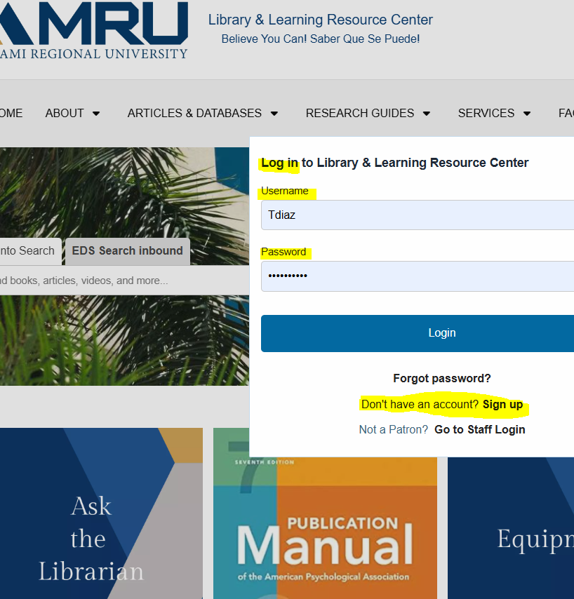
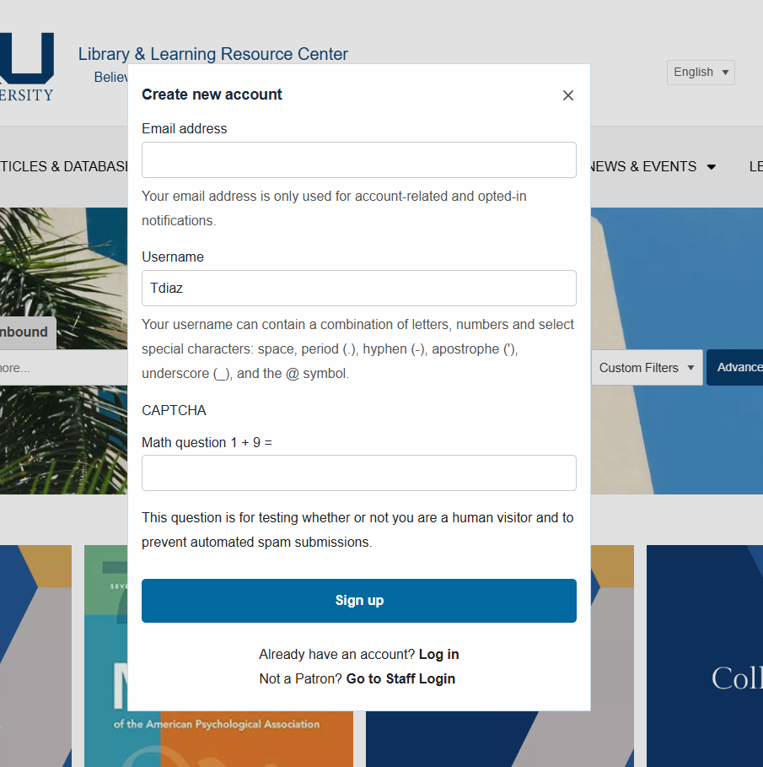
Accessing EBSCO
If you have an account:
Click Log in on the top right to log in.
If you do not have an account: Click Log in on the top right and then click Sign up. Make sure to use your MRU email.
Notes:
If you do not have a log in you will create one here using your mru email.

Slide 17
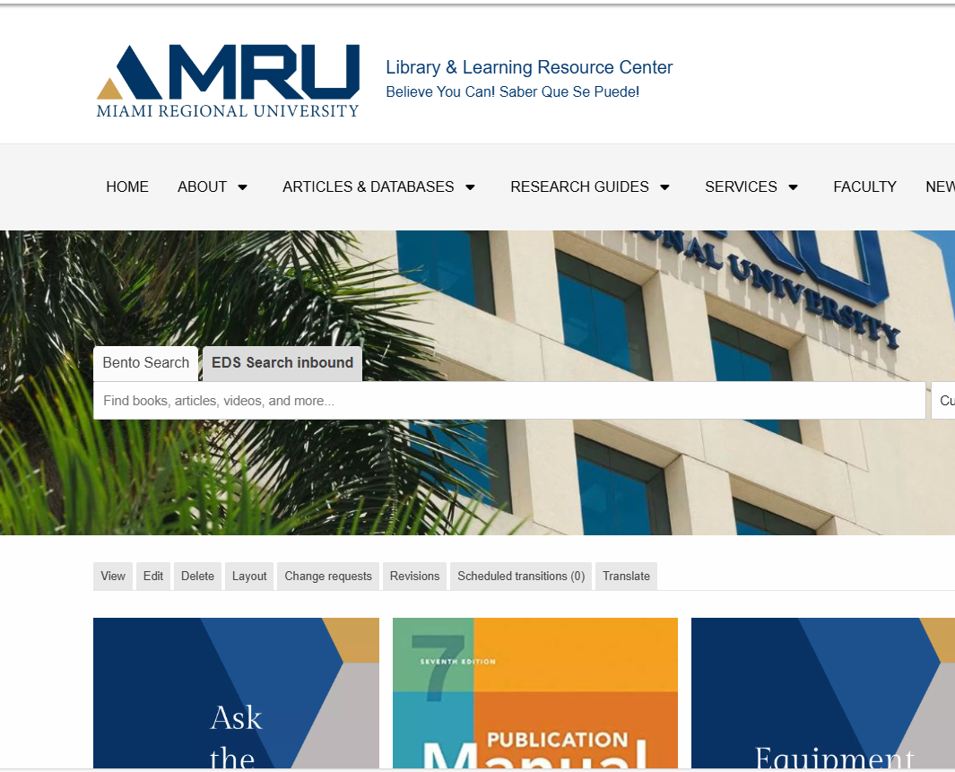
Ready to Search
Now we are ready to search EBSCO!
Notes:
Once you are logged in you are ready to search.

Slide 18

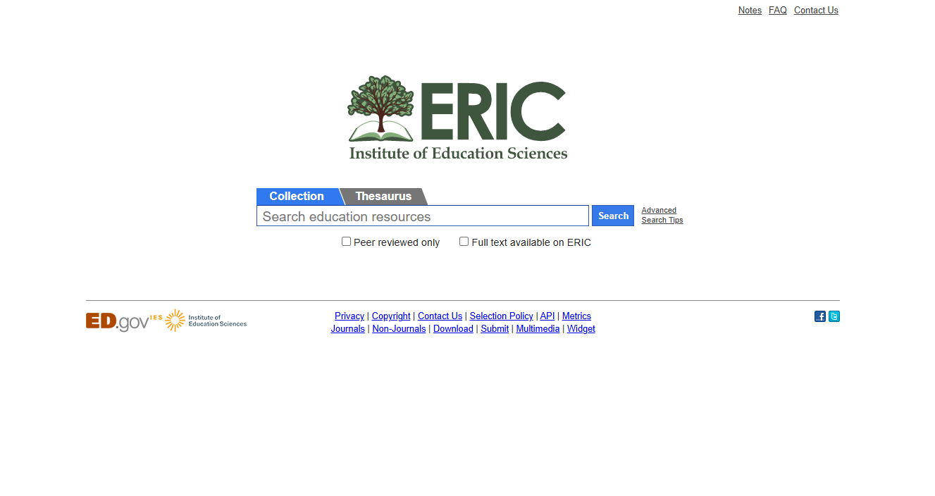
How to Access the Library ERIC Database
Notes:
To access ERIC, Simply click on ERIC in the virtual library and the database will open up ready to search. ERIC works similarly to EBSCO and is especially useful for education and healthcare topics.

Slide 19



Accessing Pre-Licensure bookshelf
Your Professor will supply you with a special code to access this database.
Notes:
The Pre-licensure bookshelf is for specific students. To access this database your professor will supply you with a special code.

Slide 20


Accessing Ask a librarian
This link will open a Teams chat where you can request help from our Librarian.
Notes:
& last but not least we have Ask a Librarian. If you need help, use the Ask a Librarian link to chat with a librarian through Microsoft Teams.

Slide 21

Basic Search
Enter keywords
1
Apply limiters: full text, peer-reviewed, date range
2
Compare PDF Full Text vs. HTML Full Text
3
Notes:
Now we know how to access the tools but how do we use them? Let’s begin with a basic search. Enter keywords into the search bar and apply limiters such as, Peer Reviewed or Full Text to narrow your results.

Slide 22
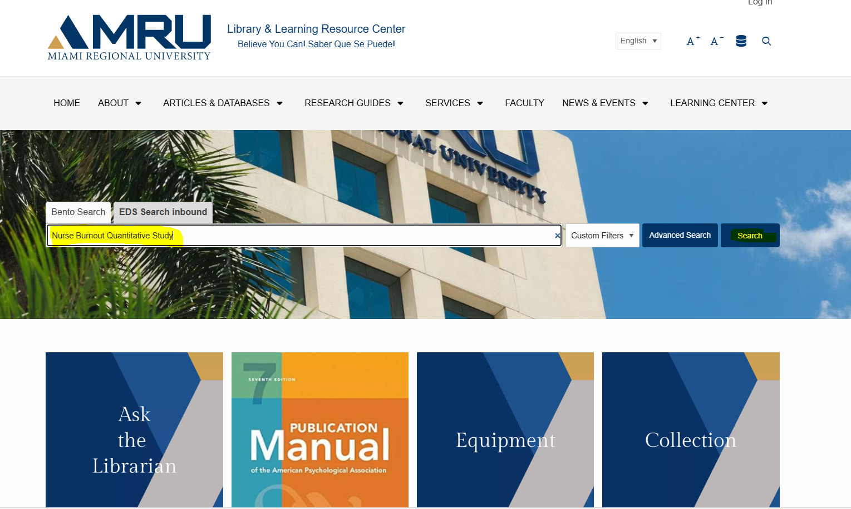
Your First Search in Ebsco
Notes:
For our search I put in "nursing burnout quantitative study". This will bring up any articles with a similar subject based on at least one of these keywords.

Slide 23
Advanced Search Strategies
Boolean Operators: AND / OR / NOT
Quotation marks → “exact phrase”
Truncation: educat* = education, educating, educator
Subject terms / thesaurus browsing
Notes:
Now, let’s refine it. If I add AND, I’ll get articles that mention both keywords. If I use OR, it broadens my search. If I type my search terms in quotes, I get that exact phrase.
Another trick: use truncation. If I type educat* with an asterisk, I’ll get results for education, educator, educating, and so on.

Slide 24
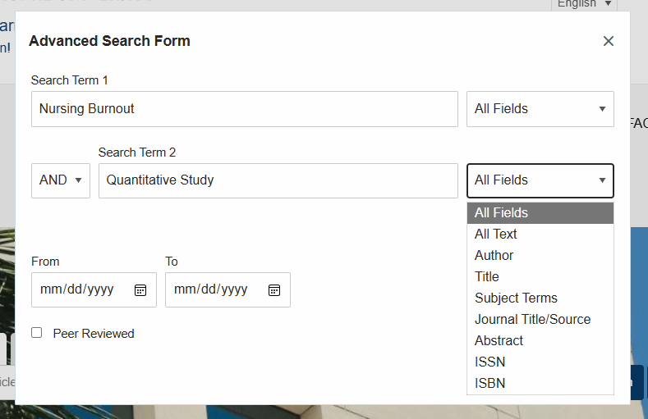
Advance Search in EBSCO
Clicking on the Advanced link in the search bar will pop up an Advanced Search form.
Here you can search by various fields, use Boolean operators, Add a field, and filter by dates.
Other Search strategies work here too.
Notes:
Going back to EBSCO let's open the advanced search tab and apply a boolean operator. Instead of "Nursing burnout quantitative study" we will now search for nursing burnout AND quantitative study. Set it to search for these terms in all fields and away we go.

Slide 25
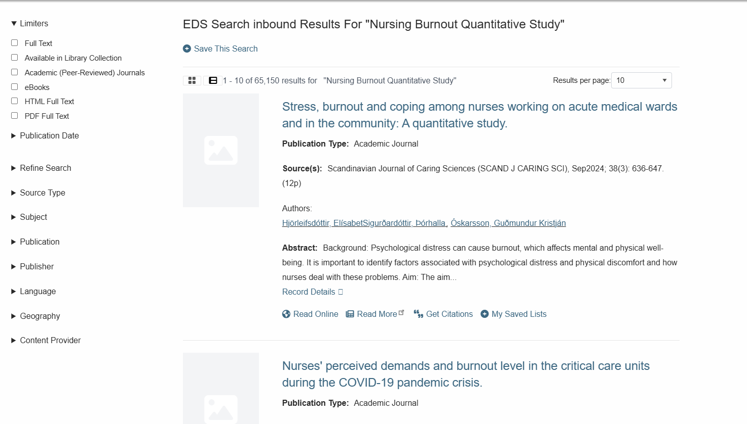
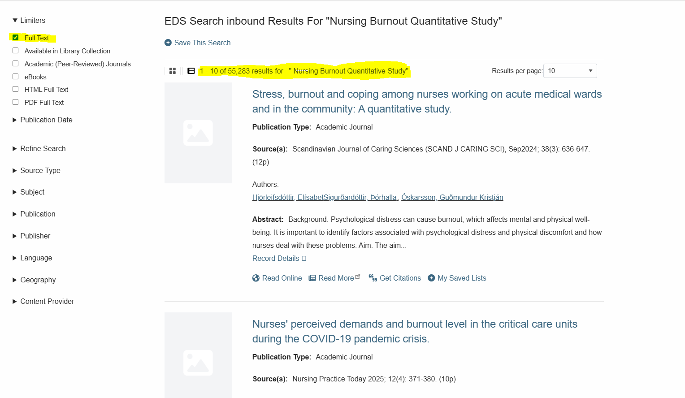
Refining your Search
The Most Important Limiter is “Full Text”
My search went from 65,150 to 55,283 articles found just by clicking “Full Text”
Use Limiters to refine your search results.
This can be done by the type of text, publication date, Subject, etc.
Notes:
Once our list populates we can use limiters to further refine our search. The Full text limiter is the most important and can be found on the left side. This will ensure you only receive articles with the full text available to you. In our search, engaging the full text limiter brought our search down from 65,150 to 55,283.

Slide 26
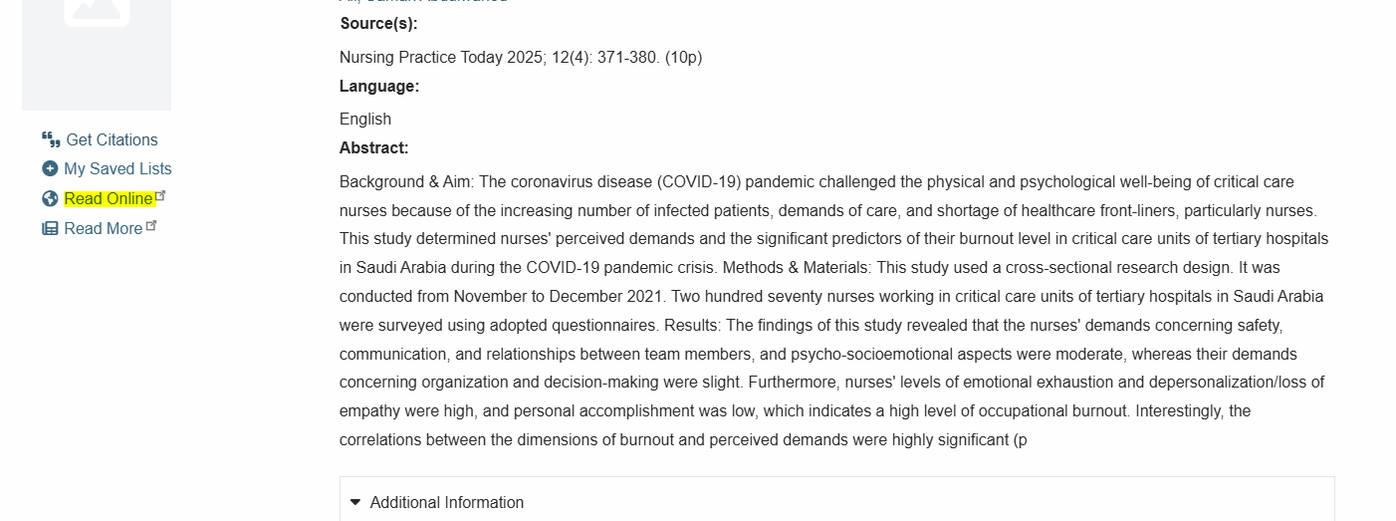
Accessing an Article in EBSCO
Once you’ve chosen an Article, click the link to open the Abstract.
Within this new page you will be able to see all the article information before accessing the actual article.
Click Read online to access the full article.
Notes:
Once you've picked out the article you want to use. Open it and read the abstract to ensure the contents are in line with the content you are creating. Then just click read online to access the full article.

Slide 27
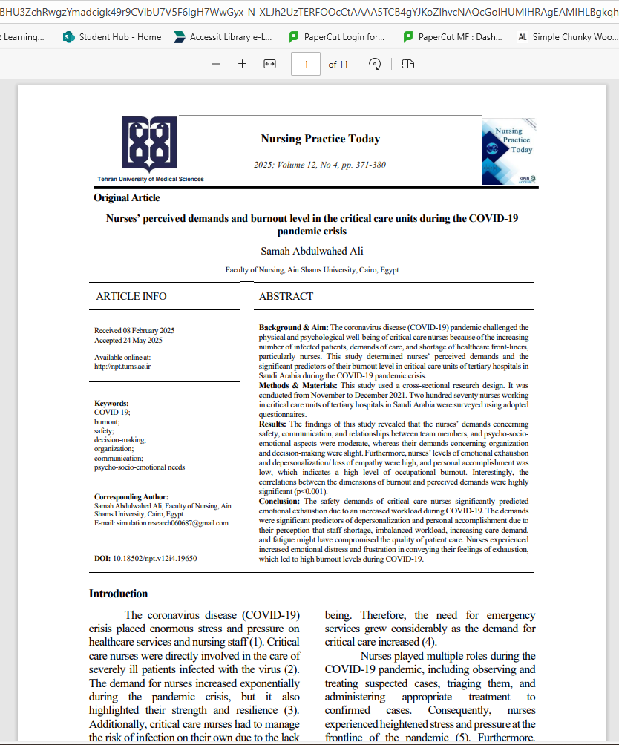
Accessing an Article in EBSCO
Notes:
& with that you’ve accessed your first article in EBSCO.

Slide 28
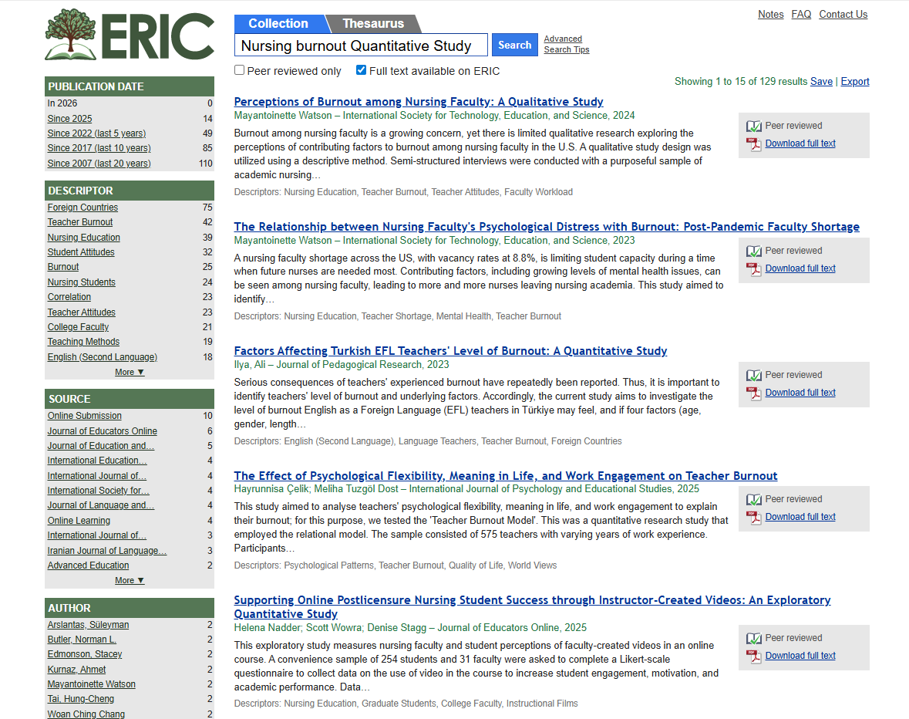
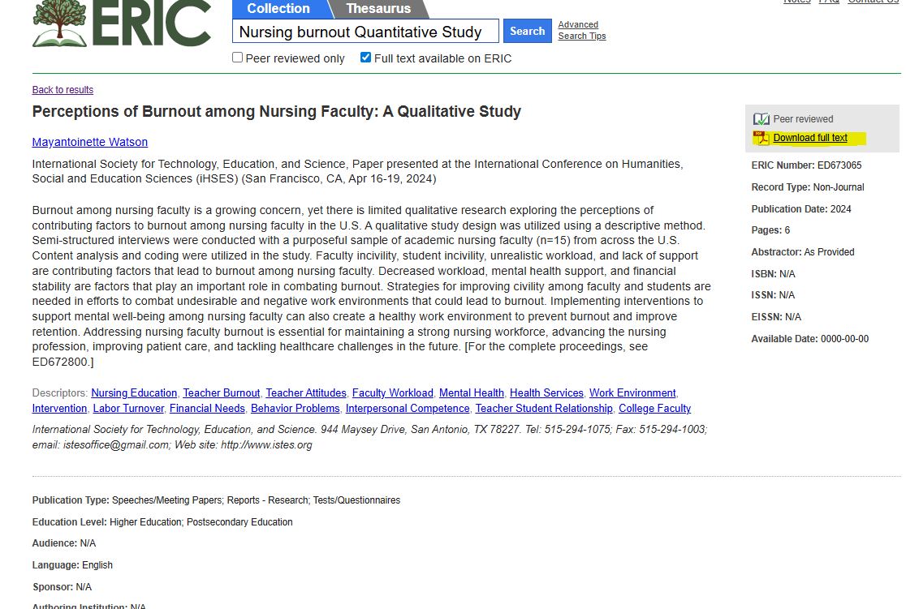
Searching & Accessing Articles in ERIC
Advance search strategies work in ERIC too.
The limiters can be found on the left hand side after your search populates.
Notes:
ERIC works similarly to EBSCO and is especially useful for education and healthcare topics. Advance search strategies work here too with limiters on the left side of the populated list. Always select Full Text Available on ERIC when making a search.
Once you have chosen an article, the abstract will populate with all the article information. Click “Download Full Text” to access the full article.

Slide 29
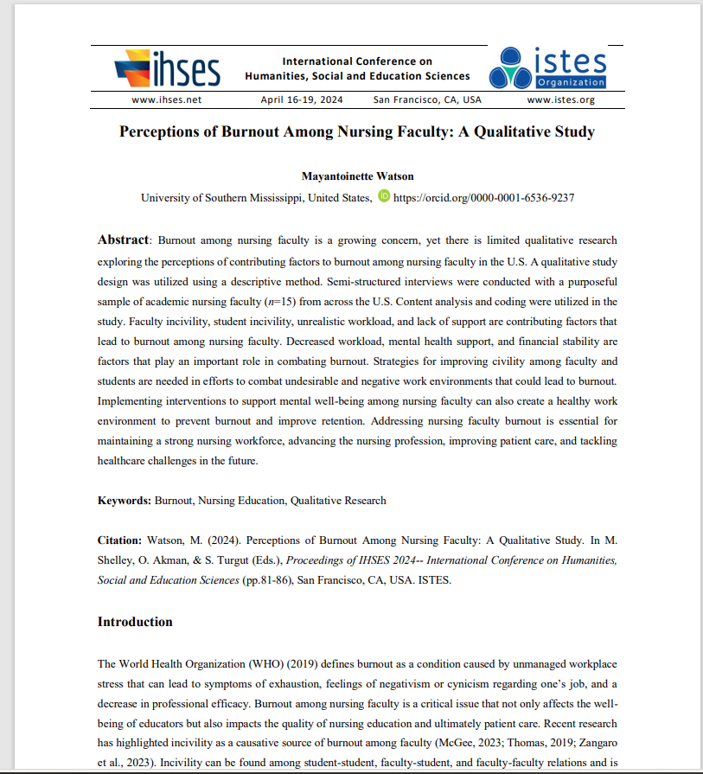
Accessing Articles in ERIC
Notes:
& with that you’ve accessed your first article in ERIC.

Slide 30
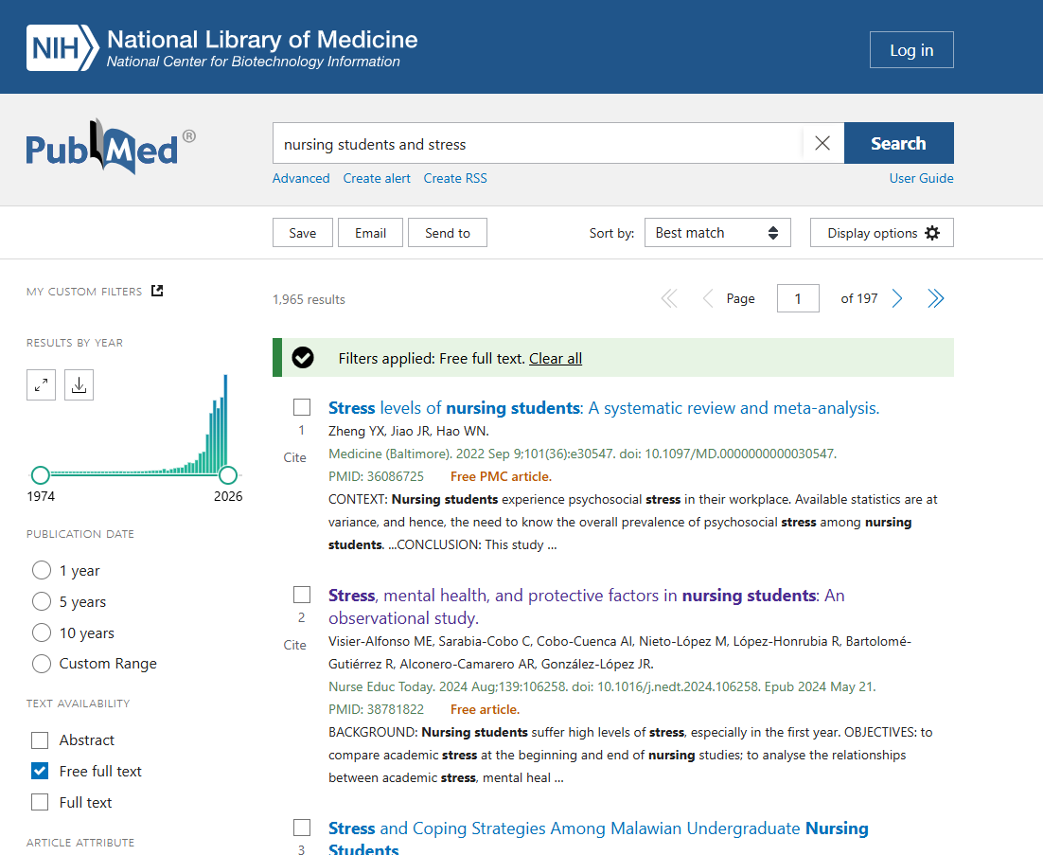
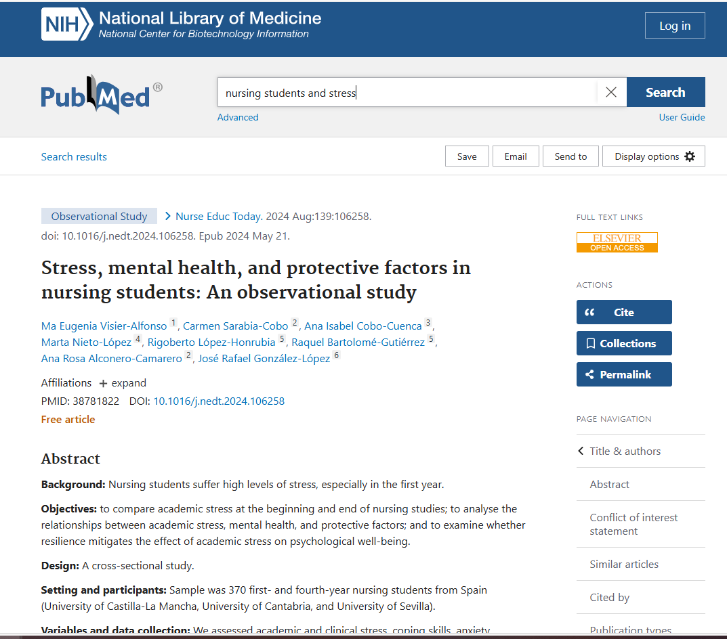


Accessing articles in LIRN
Refine your search and then access your article by clicking the full text link on the top right.
Notes:
Back in LIRN we chose PUBMED as our database. Searching will be the same here as the other databases. Simply plug in your search terms using any search strategy and click search. Once the list shows up you can apply limiters to further narrow down your search. Once you have chosen an article simply open it and a link to the full text can be seen on the top right.

Slide 31
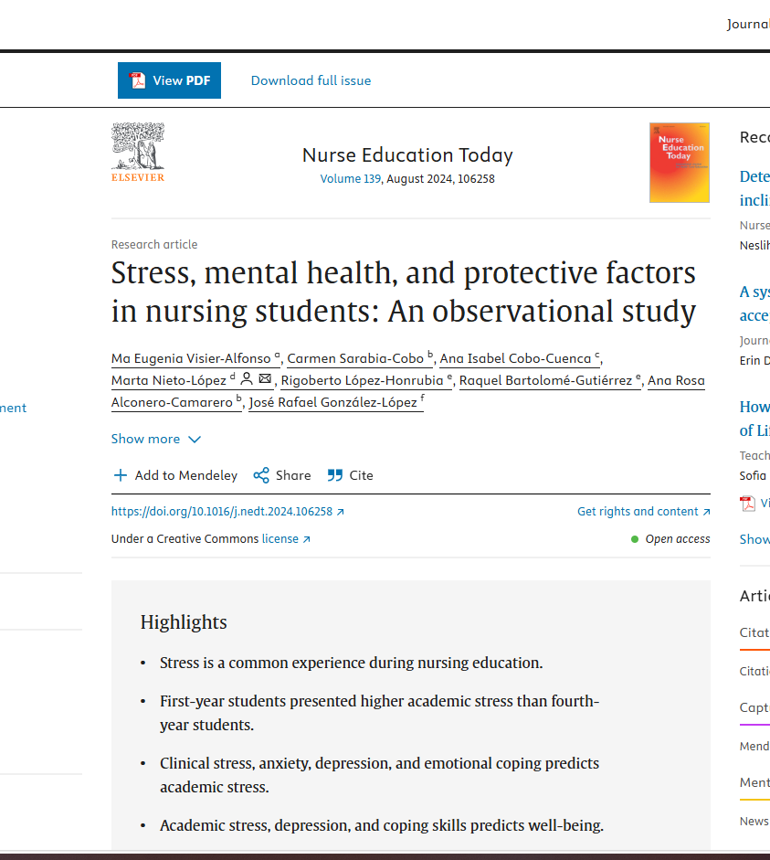
Accessing an article in LIRN
Notes:
Opening that link will give us access to the full articles location. Here we can read the text in-window or download the pdf for printing.

Slide 32


Your Turn
Search
Search for Nursing and Social Media
Try
Try one limiter
Use
Use one Boolean operator
Find
Find one relevant article
Notes:
Now it's your turn! Pick a database and search for "Nursing" AND "Social Media". Use at least 1 filter and 1 limiter. Find a relevant article and open it to view full text.

Slide 33

Managing Results
Read abstracts first
Save, email, or print articles
Use the “Cite” tool (but double-check formatting!)
Notes:
Once you’ve got results, the next step is to decide which articles are useful. Don’t dive into every PDF—read the abstract first. If it looks relevant, then download.
EBSCO also has a Cite tool, which is helpful, but here’s the warning: those citations are not always perfectly formatted. Always double-check against an APA guide.

Slide 34
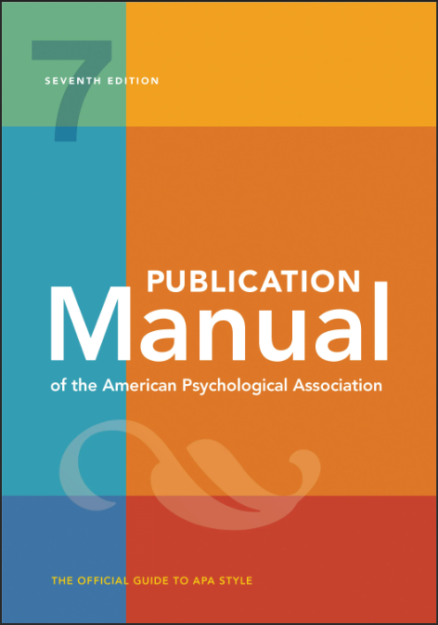
What is APA?
It is the American Psychological Association style of Writing.
MRU Requirement.
The APA manual is available
at the MRU Library!
Notes:
APA stands for the American Psychological Association style of writing and is required at MRU. You can find the APA Manual at the MRU Library on the 9th floor.

Slide 35

General APA FORMAT
Your essay should:
Be typed
Be double-spaced
Have 1” margins on each side
A preferred font is sans serif (i.e., Times New Roman – 12- point)*
Be printed on standard-sized paper (8.5”x 11”)
Paragraphs must be left aligned with each first line indented
* Other fonts include 11-point Calibri, 11-point Arial, 10-point Lucida Sans Unicode, 11-point Georgia, 10-point Computer Modern.*
Notes:
The general APA format is an paper that is typed, double-spaced with 1 inch margins all around. While there are other fonts and sizes that are allowed by the APA like Calibri and Arial. Standard practice is Times New Roman at 12 point. If it is to be printed the page must be on standard 8.5" by 11" sized paper. Paragraphs must be left aligned with the first line of every paragraph indented.

Slide 36
APA Basics
Your essay should include three major sections:
Title Page
Main Body
Introduction
1st Main point
2nd Main point
3rd Main Point
Conclusion
References Page
References
Main Body
Title page
Notes:
APA articles are comprised of 3 major sections. The title page, the main body, and the references page.

Slide 37
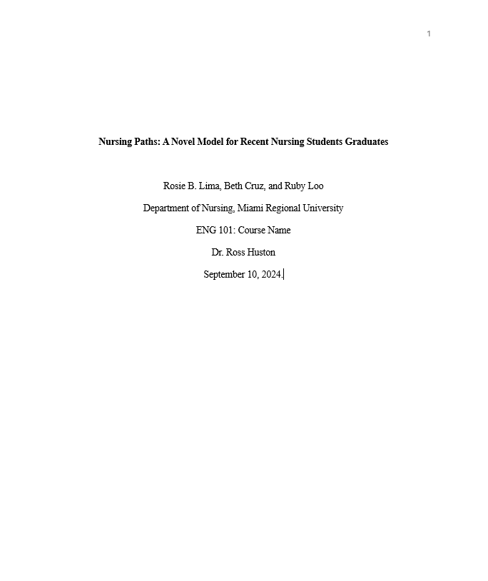
APA Basics
Page header:
Student papers contain no running head. Simply insert a page number flush right.
Title page:
The paper’s title appears in the upper half of the page, centered. Type the rest of the information after a couple of lines.
Continue with the author’s name (no title or degree) if multiple authors, separate with commas and use the word and before the last author.
Next, type the academic department, institution name, course, instructor, and your paper’s due date.
Notes:
APA style does not use a page header but does make use of page numbers. Page numbers should be flush right of every page.
The title should appear on the upper half of the page and centered. Skip a couple of lines and continue with The author's name or names. If you have multiple authors, separate the names with commas making sure to use the word AND before the last author.
Following the author's name, type the academic department, institution name, course, instructor, and your paper's due date.

Slide 38
Main Body
2
Effects of Misinformation on Memory Recall
Memory can be defined as a system that senses, organizes, stores, and retrieves information (The Human Memory, 2019). According to the APA Dictionary of Psychology (American Psychological Association, n.d.), memory can also be a representation of past events and a way of encoding and processing those events. It is the threshold between what we perceive and what we choose to remember (Roediger & DeSoto, 2015). The second type is short-term memory.
Many factors can affect memory. One factor is the encoding of memory through schemas. A schema can be defined as a structure of knowledge in the brain that is used to store information (Wagoner, 2013). Individuals use schemas to create many ways of encoding information to fit already established memories. Schemas not only allow individuals to store memories but also can lead them to reconstruct and alter memories that are processed.
Notes:
Your main body is the meat of the paper. On the first page of the main body you will simply write the name of the paper on the top center. Here you will be using in-text citations which we will discuss shortly.

Slide 39

APA Citation Basics
In-text:
(Author, Year)
Reference list:
Author, A. A. (Year). Title. Journal Name, volume(issue), pages. https://doi.org/xxxxx
Notes:
Now let’s talk citations. The basics are:
In-text citation looks like this: (Smith, 2022).
Reference list citation looks like this: Smith, J. (2022). Title of article. Journal Name, 12(3), 45–60. https://doi.org/xxxxx
APA styles uses 2 citation types. In-text citations and the reference list. Here are examples for what they look like. An Intext citation is simply the authors name and the year of publication within parenthesis. The reference list is a bit broader including the authors name, year of publication, title, journal name, volume, issue, pages and DOI information.
Some common mistakes include forgetting hanging indents, capitalizing every word in a title, or mixing up the article title with the journal title.

Slide 40
In-Text (Parenthetical) Citation
When paraphrasing or quoting another author’s work directly in your paper, use in-text citations. They are called parenthetical or narrative citations.
Citations must include the author’s last name and the year of publication for the source, e.g. (Johnson, 2008).
Include the page number for direct quotations (preceded by “p.”)
Both paraphrases and quotations require citations.
Cite only works that you have read and ideas that you have incorporated into your writing.
2
Main Body - Citations
Notes:
So when do we use In-text citations? Here are a few examples of when to use intext citation. Though a rule of thumb is "if you didn't write it you must cite it." This includes paraphrasing. An in-text citation is the authors last name with the year of publication inside parenthesis. See here (Johnson, 2008). If you are using a direct quote you will also want to include a page number. It is very important to cite your sources to avoid plagiarism.

Slide 41
Direct quotation with author’s name as part of the narrative:
According to Moors (2008), “the best way for students to learn APA formatting is with practice” (p. 16).
Direct quotation with parenthetical citation:
Moors (2008) found "it is best for students to ask for help before turning in a paper that needs APA style" (p. 199).
Paraphrase or summary of information from another author:
APA style becomes easier the more you use it (Moors, 2008).
When citing two authors
Whenever you use another author's work, use citation to stay out of trouble (James and Luca, 1999).
When citing three authors or more
APA style is used in the fields of psychology, nursing and health sciences, and engineering (Bali et al. 2018).
Narrative citation
Madison (2023) investigated the risks related to consistently eating cereal for breakfast.
Parenthetical citation
There are risks inherent in eating cereal for breakfast (Madison, 2023).
In-Text Citation Examples
Notes:
here are some examples of when and how to use in-text citations. The style of in-text citation will change depending on your style of writing.

Slide 42
References Page: Basics
It has it own separate page, may be one of more pages
Capitalize all major words in journal titles
Italicize titles of longer works such as books and journals
Notes:
Full citation references must be put on a separate page titled "References." This comes with it's own set of rules. Make sure you capitalize all major words in journal titles and italicize titles of longer works such as books and journals.

Slide 43
APA Reference Entry in details
Scholarly Article from an Academic Database
Author, A. A., Author, B. B., & Author, C. C. (Publication Year). Title of article: Subtitle also capitalized. Title of Periodical, volume number(issue number), page range.
Authors: Last name, Initials. (date). Title of the article.
Perez, M., & Huston, L. K. (2000). Trauma and memory: A cognitive approach. Journal of American Pediatric Nursing, 15(3), 23-30.
Starting page – end page.
volume # (issue #), Title of the journal in which the article appears,
Notes:
Here is a detailed look at a reference page entry. You can see here that the citation is made up of several components. The authors, date, title of article, title of publication, volume, issue, and pages.

Slide 44
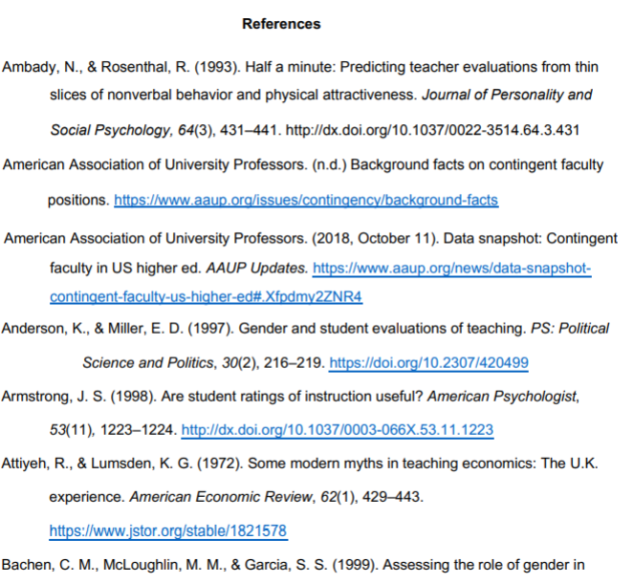
Reference Page
Center the title (References) at the top of the page. Bold this title.
Double-space reference entries.
Flush left the first line of each entry and indent subsequent lines (hanging indentation).
Order entries alphabetically by the surname of the first author of each work
Notes:
This is an example of a reference page. Here you will list all sources used in your work.
Reference page format includes the "references" title to be on the top center of the page and in bold. All reference entries must be double spaced and flushed left on the first line with subsequent lines indented. References must be alphabetically ordered by author's last name. If a source is anonymous, use its title as an author’s surname.
Note: Unlike MLA, APA is only interested in what they call “recoverable data”—that is, data which other people can find. For example, personal communications such as letters, memos, emails, interviews, and telephone conversations should not be included in the reference list since they are not recoverable by other researchers.
For specific information about entries in the reference list, go to https://owl.purdue.edu/owl/research_and_citation/apa7_style/apa_formatting_and_style_guide/reference_list_basic_rules.html

Slide 45
Reference Page Citation Examples:
Books
Author, A. A. (Year of publication). Title of work: Capital letter also for subtitle. Publisher.
Lopez, M. A. (1970). Landscape painting: Developing your inner creativity. Random House.
E-Books
Author, A. A. (Year of publication). Title of work: Capital letter also for subtitle. Publisher. http://www.publisherhomepageurl
Jensen, S. (2012). Noise: The power of extroverts in a fast world. Hollywood Books.
Cite e-books like the printed version if found in an academic research database.
Include the DOI if there is one.
Notes:
Here are a few more examples of reference page citations.

Slide 46
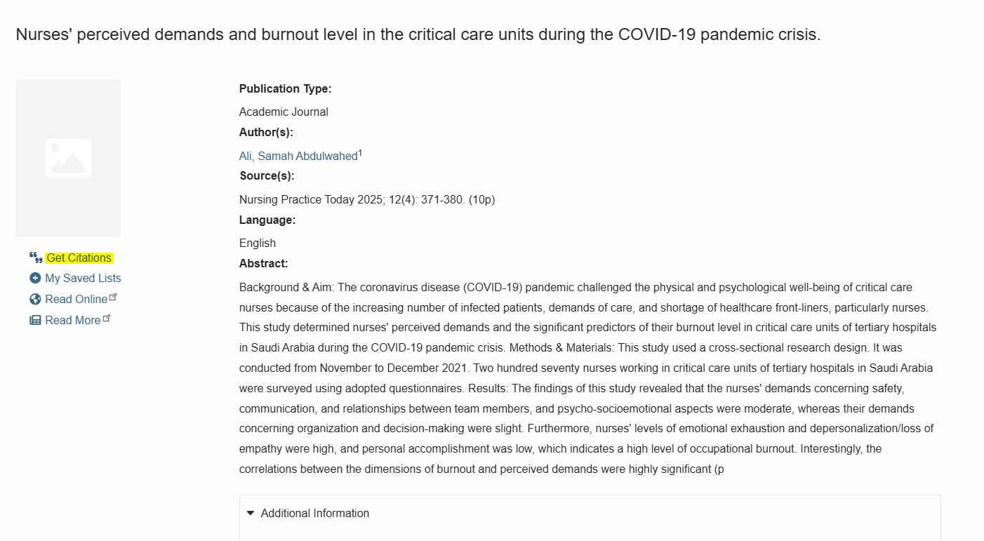
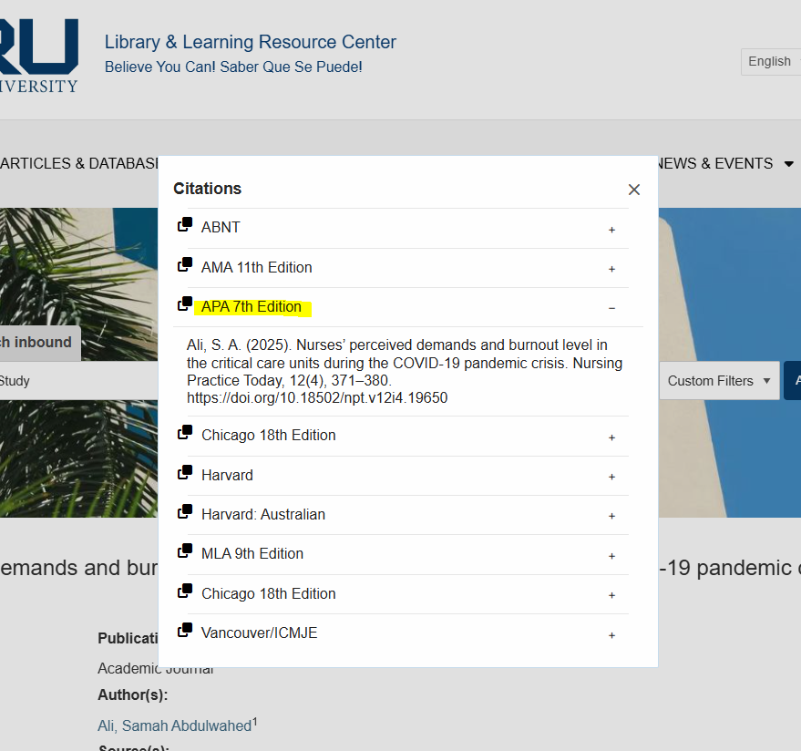
Citation Tool in EBSCO
*Always Double Check it for Errors.
Notes:
Some Databases include citation tools. Like this one in EBSCO. Citation tools can be helpful, but always double-check them for accuracy.

Slide 47
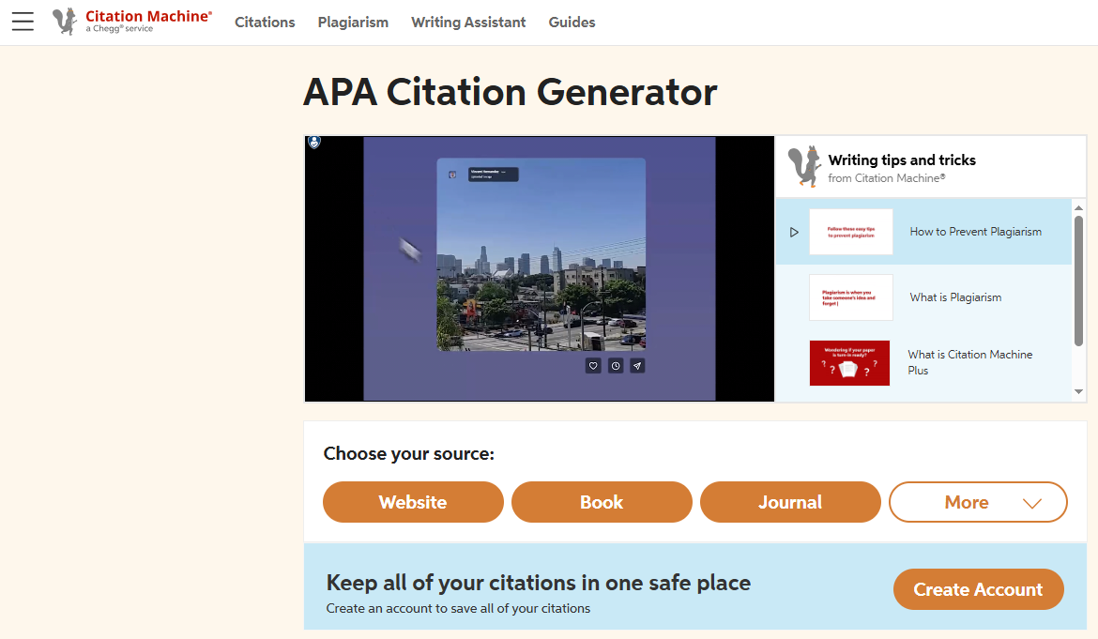
3rd Party Citation Generators
If you are using a 3rd party citation generator like Citation machine, it is important to always double check it for errors in formatting.
https://www.citationmachine.net/apa
Notes:
3rd party citation generators can also be useful but beware to check for errors in formatting.

Slide 48

Avoid These Common Mistakes
Forgetting hanging indents
Incorrect capitalization
Using article title instead of journal title
Notes:
Common APA mistakes include incorrect capitalization, missing hanging indents, and citing article titles instead of journal titles.

Slide 49
Your Turn
Take the article you found or find a new one.
Open it to view the full text.
Quote the article with in-text citation in APA 7 Format.
Do a full APA 7 Reference Page Citation.
Notes:
Now it's your turn!
Take the article you found before or search for a new one. Access the full text and quote the article with in-text citation. To take it a step further create a references page for this quote.

Slide 50






Where to Find RESOURCES
The Purdue OWL: APA Style Guide http://owl.purdue.edu
The APA’s Official Website http://www.apastyle.org
APA, 7th ed. (Spanish) https://normas-apa.org/
APA, 7th ed. (French) https://ustboniface.libguides.com/citer/apa7
Miami Regional University: Writing & Research Resources https://na.accessit.online/MMR00/?serviceId=ExternalEvent&rlSn=10&rlKey=1681343490
Harvard College Writing Center: Strategies for Writing Essays https://writingcenter.fas.harvard.edu/pages/strategies-essay-writing
Notes:
Here are some helpful resources for writing in APA style.

Slide 51
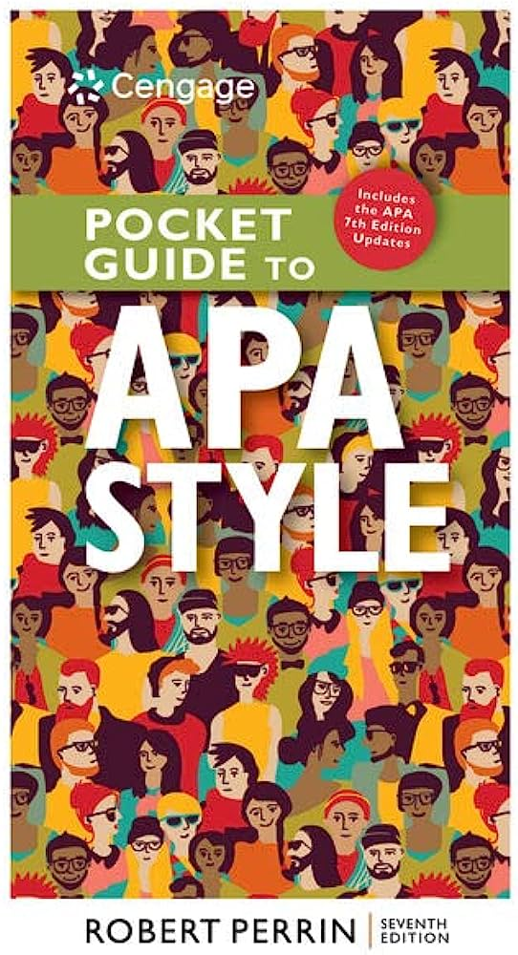
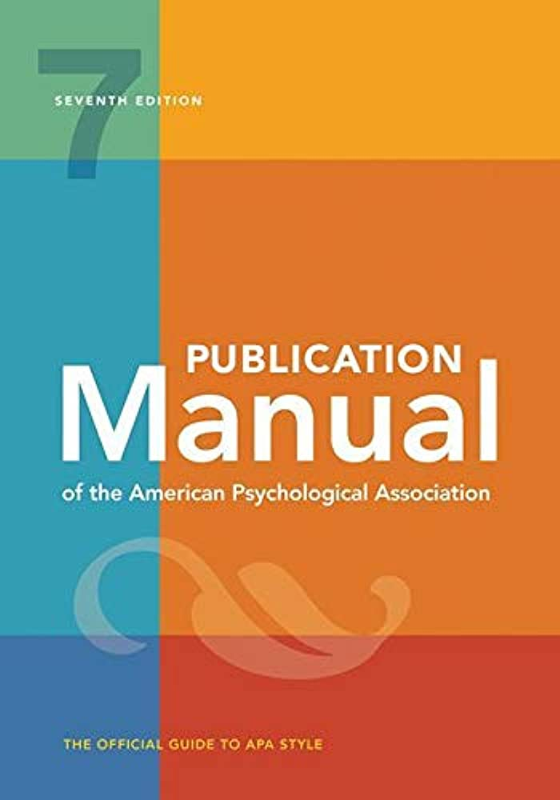
WITHIN the Miami regional university library ON THE 9TH FLOOR
Notes:
And of course, you can find the latest APA publication manual right on campus in the Library on the 9th floor.

Slide 52
Your library team is here to help
MRU Library & Learning Resources Center
library@mru.edu (305) 442-9223 ext. 6018
Liseth Soldevilla, Senior Academic Librarian lsoldevilla@mru.edu (305) 442-9223 ext. 6045
Tatiana Diaz, Assistant Academic Librarian
tdiaz@mru.edu
Natalie Bacon, Academic Library Technician
abacon@mru.edu
Notes:
To wrap up, remember The MRU Library team is here to help. You can visit us on the 9th floor or contact us by email or phone.

Slide 53
References
American Psychological Association. (2020). Publication Manual of American Psychological Association (7th ed.).
Harvard College Writing Center. (n.d.). Strategies for essay writing. Harvard College Writing Program. https://writingcenter.fas.harvard.edu/pages/strategies-essay-writing
Purdue Online Writing Lab. (n.d.). General Writing FAQs. Purdue Online Writing Lab. https://owl.purdue.edu/owl/general_writing/general_writing_faqs.html
Apa Citation Generator. Citation Machine, a Chegg service. (n.d.). https://www.citationmachine.net/apa

